Slide 1
The Jasper Ridge Global Change Experiment

Slide 2
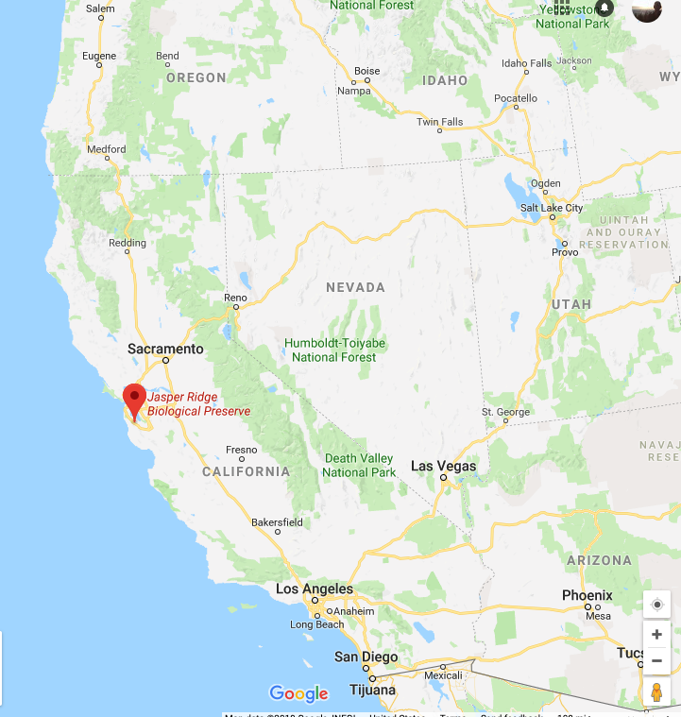
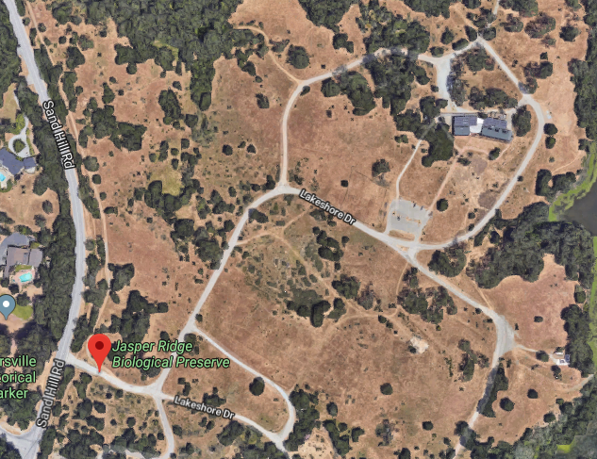
The Jasper Ridge GCE: location
Annual grassland
Mediterranean climate

Slide 3
The Jasper Ridge GCE: treatments
CO2 (FACE)
Ambient
680 ppm
Temperature (heaters)
Ambient
Ambient + 1°C
Precipitation (sprinklers)
Ambient
150% Ambient
Nitrogen (fertilizer)
None
+5 g m⁻² yr⁻¹
*Treatments included all combinations*

Slide 4
The Jasper Ridge GCE: measurements
Root and shoot biomass
Plant community diversity

Slide 5
Assignment: develop a hypothesis for how you would expect the treatments to impact the measured variables.

Slide 6
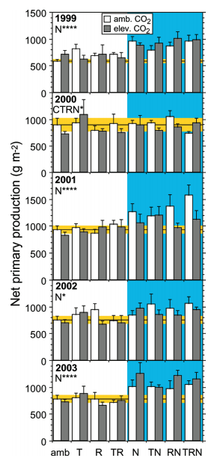
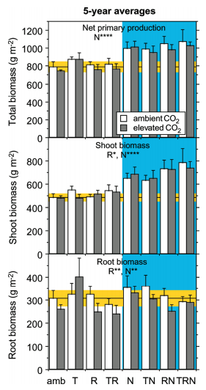
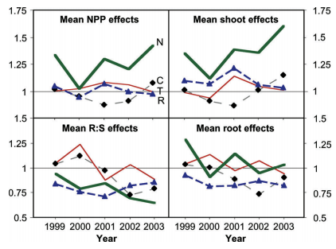
Biomass
Dukes et al. (2005)

Slide 7
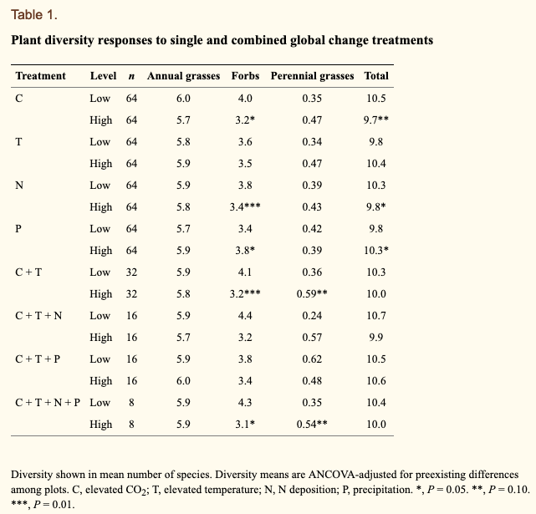
Diversity
Zavaleta et al. (2003)

